Slide 1

A Decision Tree Classification Model for University Admission System
Pattern Analysis and Machine Intelligence
Submitted by: Sumedha
M.Tech (S.P.D.D)
Second Semester
Roll No.: 2K19/SPD/17

Slide 2
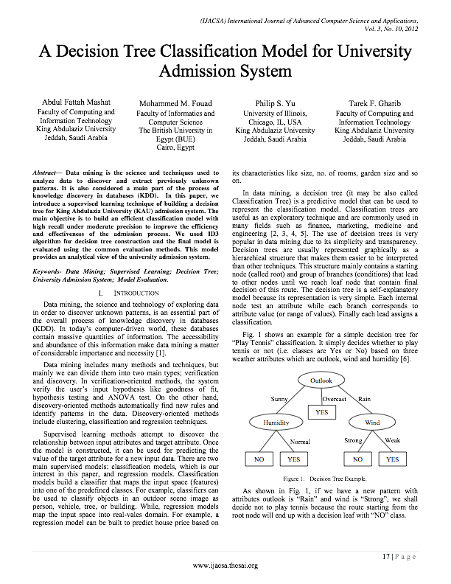
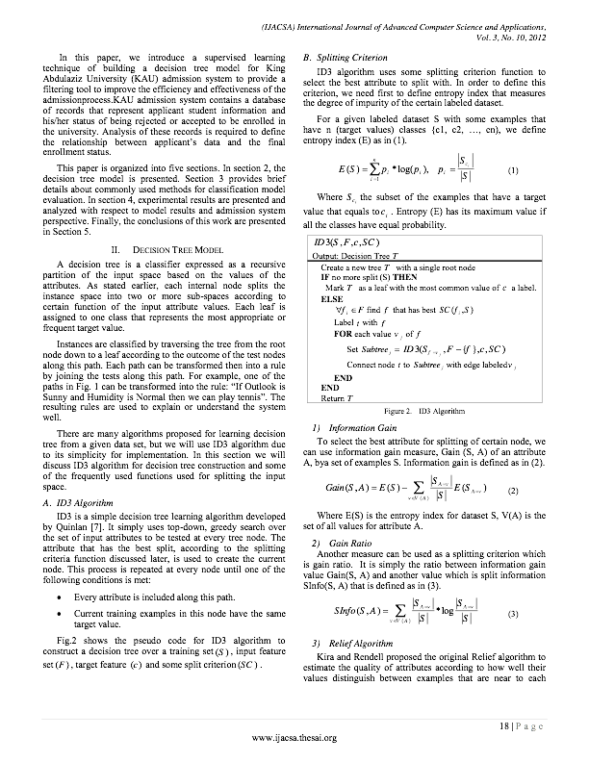
Research paper

Slide 3
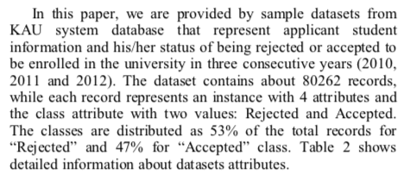
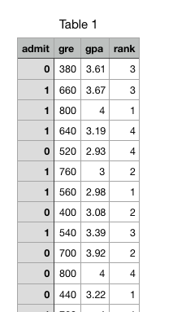
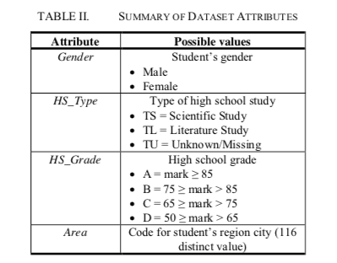
Dataset used
Dataset Used in Research Paper:
Admission Dataset from King Abdulaziz University (KAU)
Dataset Used while implementing Research Paper
UCLA institute of Digital Research and Education Graduate admission data
Source: Kaggle

Slide 4
Algorithm
Step-1: Begin the tree with the root node, say S, which contains the complete dataset.
Step-2: Find the best attribute in the dataset using Attribute Selection Measure (ASM).
Attribute Selection Method:
Information Gain: It calculates how much information a feature provides us about a class.
It is the measurement of changes in entropy of a dataset based on an attribute.
Information Gain= Entropy(S)- [(Weighted Avg) *Entropy(each feature) ]
Entropy: It specifies randomness in data. Entropy can be calculated as: Entropy(s)= -P(yes)*log2 P(yes)- P(no)*log2 P(no) Where, S= Total number of samples P(yes)= probability of yes P(no)= probability of no

Slide 5
Algorithm
Step-3: Divide the S into subsets that contains possible values for the best attributes.
Step-4: Recursively make new decision trees using the subsets of the dataset created in step -2 and 3. Continue this process until a stage is reached where we cannot further classify the nodes and called the final node as a leaf node.

Slide 6
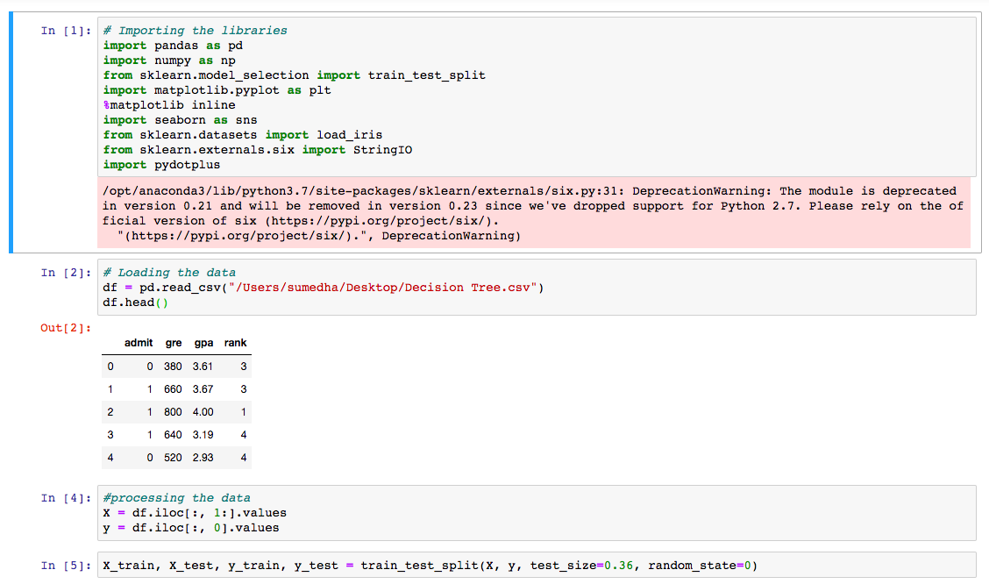
Code

Slide 7
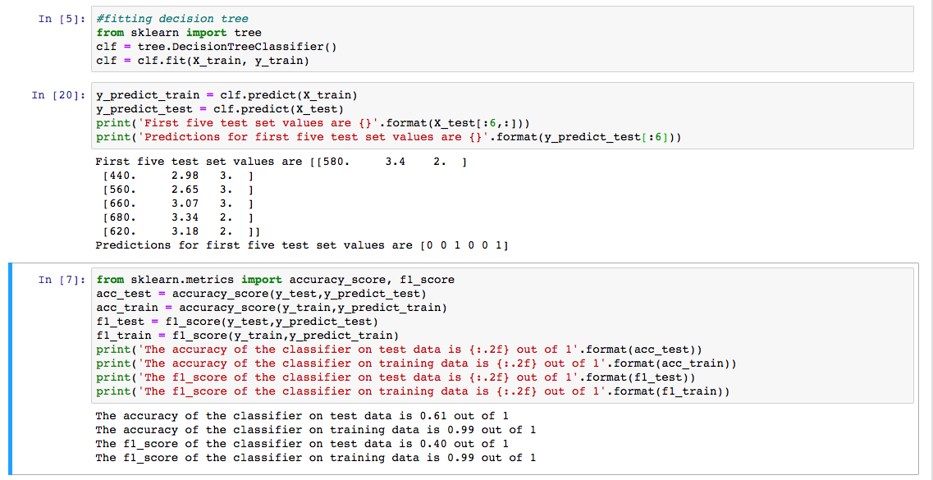
Code

Slide 8
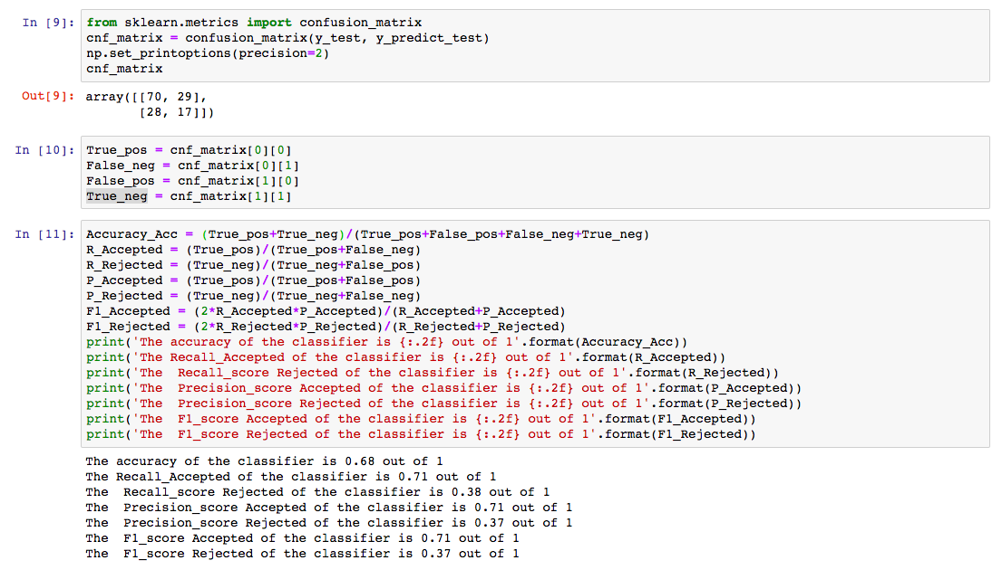
Code

Slide 9
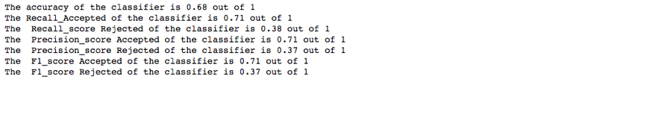
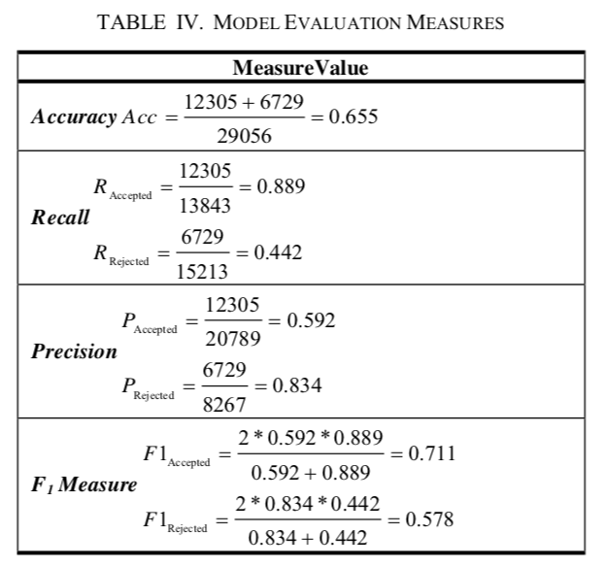
OUTPUT COMPARISION
Output obtained while implementing Research Paper
Output in Research Paper:

Slide 10
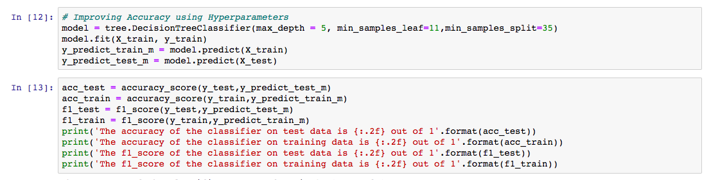
Improving evaluation measures using hyper parameters
Output
Output when hyper-parameters are not used

Slide 11
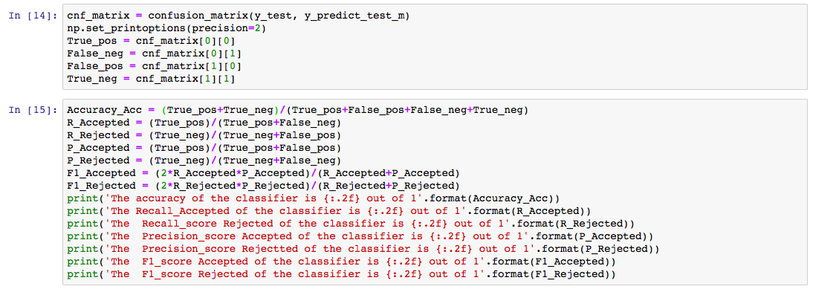
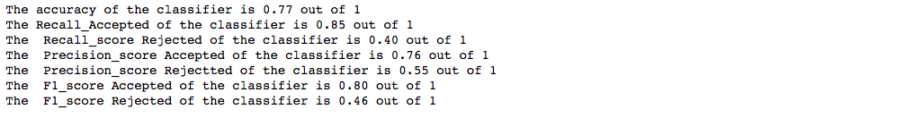
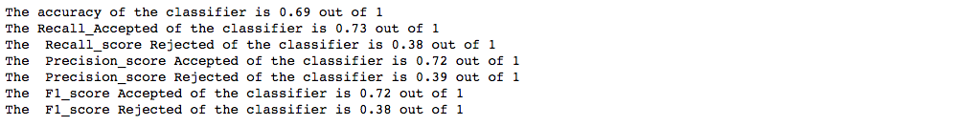
Improving evaluation measures using hyper parameters
Output
Output when hyper-parameters are not used

Slide 12
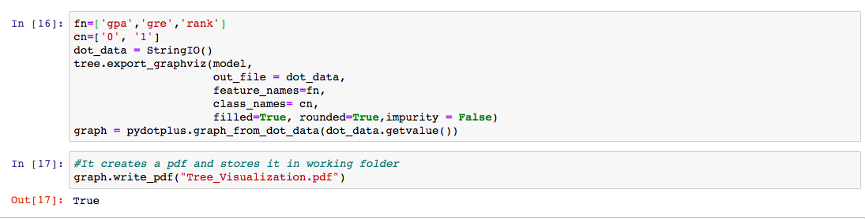
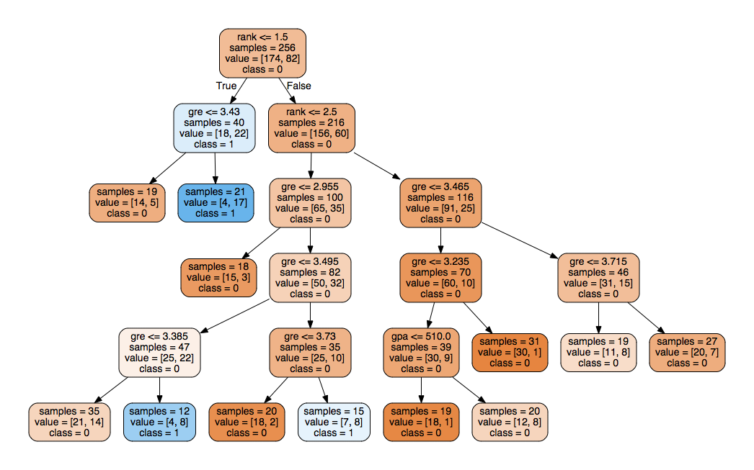
Visualizing decision tree
Output

Slide 13
ADVANTAGES
Simple to understand
Less requirement of Data Cleaning
disADVANTAGES
May have over-fitting issue
As number of labels increase computational complexity also increases

